Slide 1

Point of sale and inventory system: Serenitea
Presented by: Devon Uñalivia and Gen-Rev Valdez

Slide 2

Forms to be presented:
Serenitea: POS and inventory system

Slide 3

Startup FORMS
LOGIN FORM/MAINFORM

Slide 4
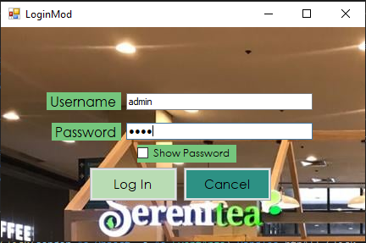
Login form
Call Retrieve Record to get Login information of users
System Password Character for Show Password

Slide 5

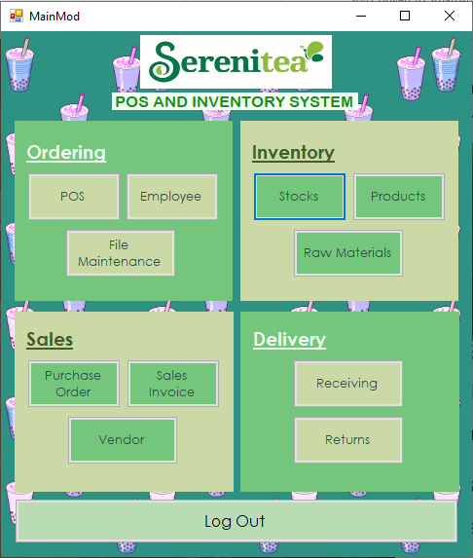
Main form
Select Case for different types of users
Admin (all access granted)
Cashier (POS access only)
HR (File Maintenance Access only)
.Show() syntax to view different forms

Slide 6
SERENITEA: POS AND INVENTORY SYSTEM FORMS
ORDER MODULE | INVENTORY MODULE | SALES MODULE | DELIVERY MODULE
POS | STOCKS | PURCHASE ORDER | RECEIVING
EMPLOYEE | PRODUCTS | SALES INVOICE | RETURNS
FILE MAINTENANCE | RAW MATERIALS | VENDOR | -

Slide 7
Order module
POS/FILE MAINTENANCE/EMPLOYEE

Slide 8
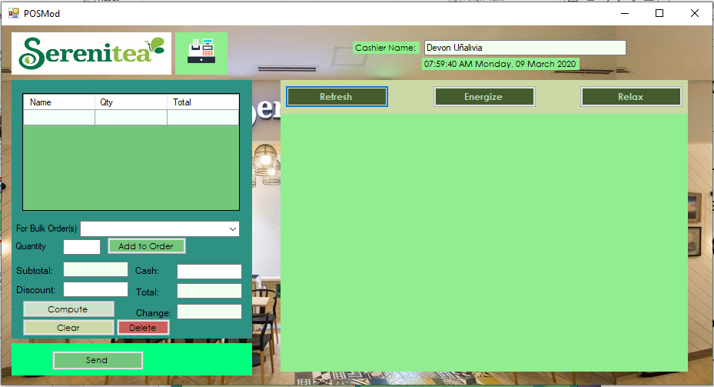
POS FORM

Slide 9
POS fORM
Call AddEditDeleteRecord to put transaction into Sales Invoice and subtract from Stocks
For Loop for computing
.Show() to call POSforms in panel
Timer Tick for Date and Time
Select to call user info and show the name of the person logged in

Slide 10
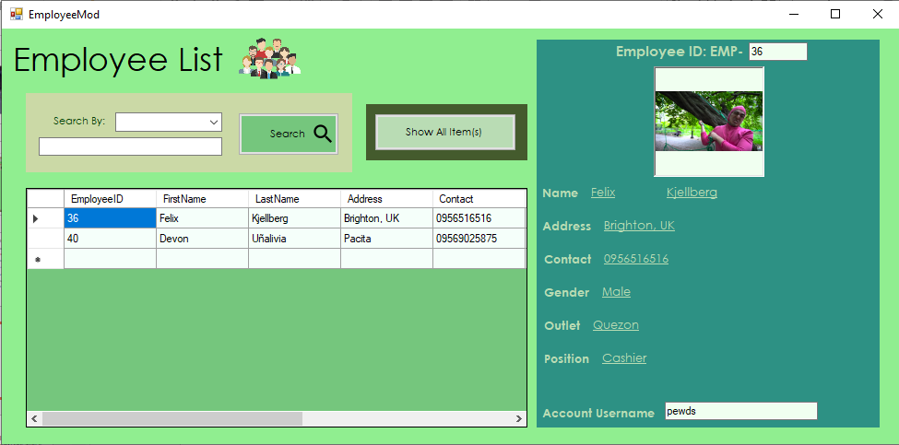
Employee form

Slide 11
Employee form
.Refresh and Public Function with Select to Refresh DataGrid
If Else for Search by Category
Call Retrieve Record and DataGrid.CurrentRow.Index to display Employee Info

Slide 12
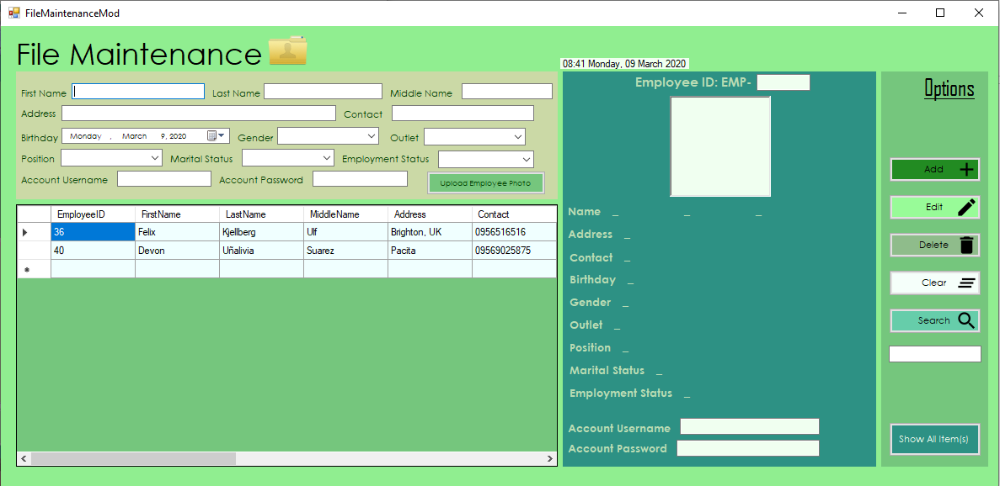
File Maintenance Form

Slide 13
File maintenance form
.Refresh and Public Function with Select to Refresh the DataGrid
If Else for Search by Category
Call Retrieve Record and DataGrid.CurrentRow.Index to display Employee Info

Slide 14
INVENTORY module
STOCKS/PRODUCTS/RAW MATERIALS

Slide 15
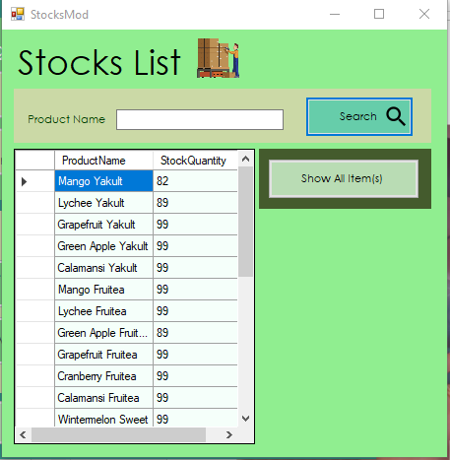
Stocks form
.Refresh and Call Public Function to refresh DataGrid
SELECT for Search
Datasource Connection to DataGrid

Slide 16
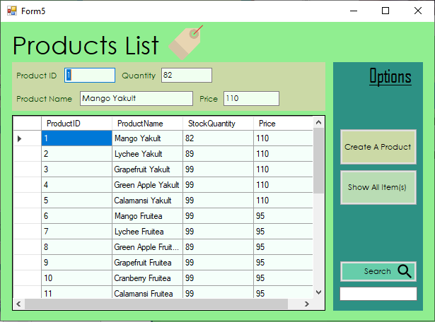
Products Form
.Show() to open ProdBuilderForm
.Refresh and Call Public Function to refresh DataGrid
SELECT for Search
Datasource Connection to DataGrid
Call Retrieve Record and DataGrid.CurrentRow.Index to display Products Info

Slide 17
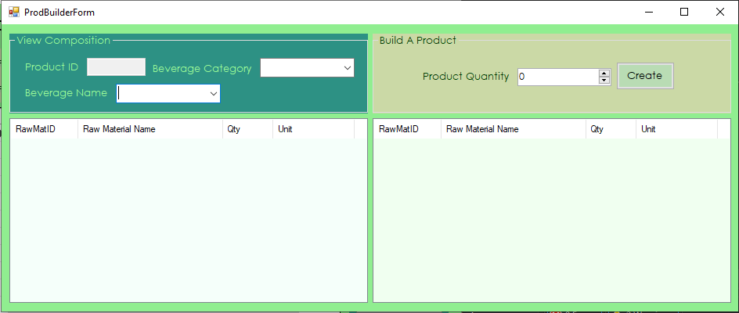
Product builder form

Slide 18
Product builder form
AddProduct as Function
Select Case for AddProduct
INNER JOIN for building products

Slide 19
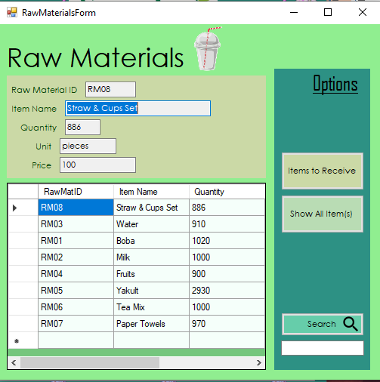
Raw Materials form
.Show() to open Items to Receive
.Refresh and Call Public Function to refresh DataGrid
SELECT for Search
Datasource Connection to DataGrid
Call Retrieve Record and DataGrid.CurrentRow.Index to display Raw Materials Info

Slide 20
SALES module
PURCHASE ORDER/SALES INVOICE/VENDOR

Slide 21
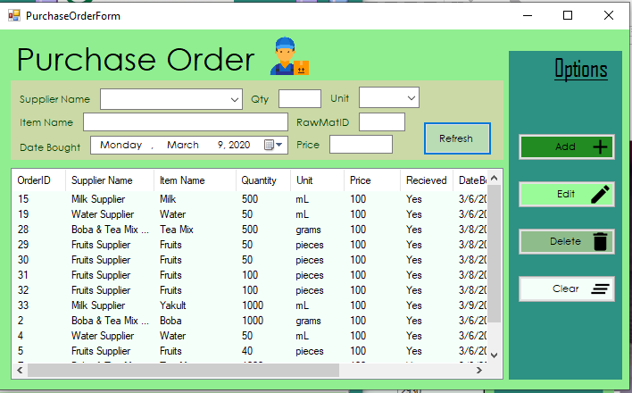
Purchase order form

Slide 22
purchase order form
.Refresh and Public Function with Select to Refresh the ListView
Call Retrieve Record and Listview.CurrentRow.Index to display Purchase Order Info
AddEditDeleteRecord for New Purchase

Slide 23
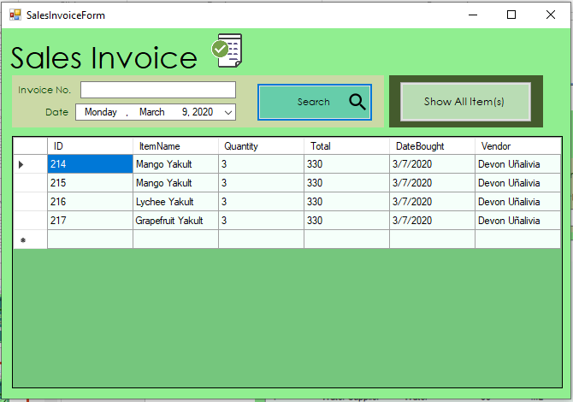
Sales invoice form

Slide 24
Sales invoice form
.Refresh and Public Function with Select to Refresh the DataGrid
Call Retrieve Record and DataGridView.CurrentRow.Index to display Sales Invoice Info
Select for Search of Invoice No.

Slide 25
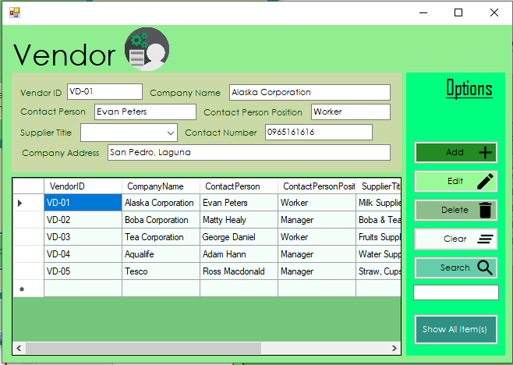
Vendor form

Slide 26
Vendor form
.Refresh and Public Function with Select to Refresh the DataGrid
If Else for Search by Category
Call Retrieve Record and DataGrid.CurrentRow.Index to display Vendor Info
AddEditDeleteRecord for New Vendor

Slide 27
DELIVERY module
RECEIVING/RETURNS

Slide 28
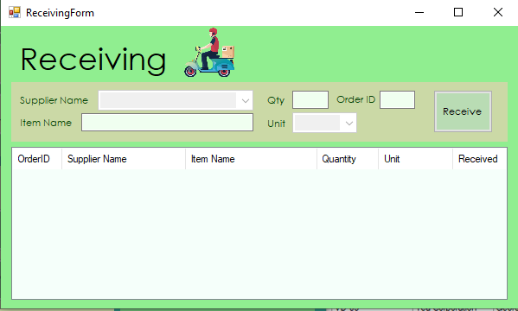
Receiving form
Call Retrieve Record and DataGrid.CurrentRow.Index to display Vendor Info
AddEditDeleteRecord for adding to Raw Materials when received

Slide 29
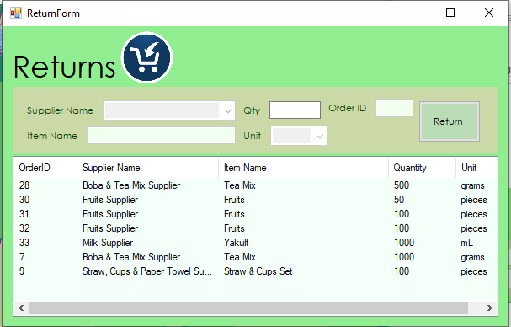
returns form
Call Retrieve Record and DataGrid.CurrentRow.Index to display Vendor Info
AddEditDeleteRecord for subtracting from Raw Materials when received
Qty can be modified

Slide 30

SERENITEA: POS AND INVENTORY SYSTEM

Slide 31

THANK YOU
DEVON UÑALIVIA AND GEN-REV VALDEZ

